Slide 1
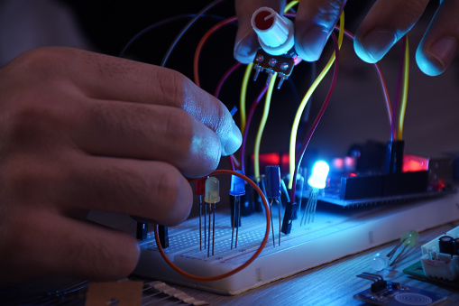


BORCELLE
MEASUREMENT & INSTRUMENTATION
MINIPROJECT

Slide 2
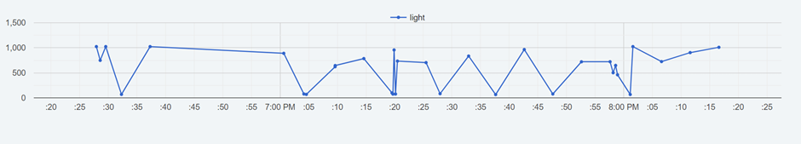

CONTENTS
01
02
03
04
05
06
The Project
Our Team
About
Objectives
Flowchart
Sensor Details
07
08
09
10
11
12
Connections
Arduino Code
LabVIEW
Simulations
Hardware
Conclusion

Slide 3
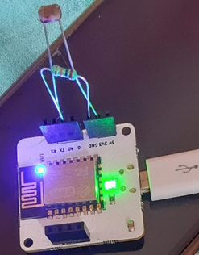
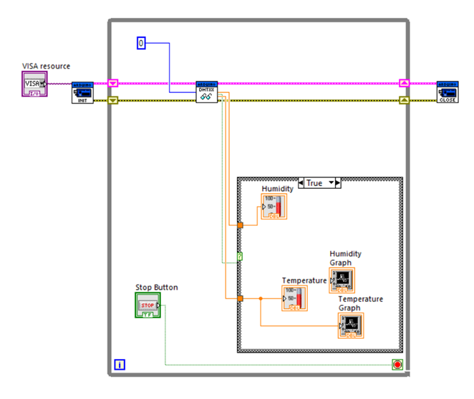

SYSTEM FOR
PLANT-CARE
SENSES - LIGHT INTENSITY, TEMPERATURE AND HUMIDITY

Slide 4

OUR TEAM
Shashank Pandey
210906204
Tithi Mishra
210906206
Praanzal Prayas
210906130

Slide 5
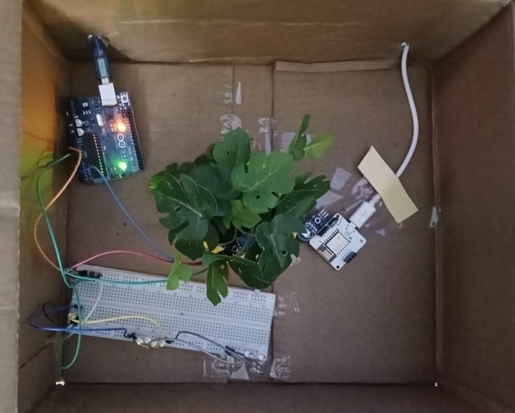


ABOUT OUR PROJECT
The "Plant Care System – Soil Moisture and Light Intensity Level Detector" project represents a pioneering approach to addressing the growing need for efficient and sustainable plant care in various settings,
This project aims to harness the power of modern technology to create a comprehensive and intelligent plant care solution that goes beyond traditional methods. By combining advanced sensors, Arduino, Wi-Fi Modules, and user-friendly interfaces.

Slide 6



GOALS AND OBJECTIVES
01
Main objective: To make an efficient Plant Care System that takes care of our miniature garden even when we are not at home.
02
To measure the light intensity received by the phytotropins of plants
03
To measure the moisture content of the soil and whether or not it’s adequate for our plant.

Slide 7
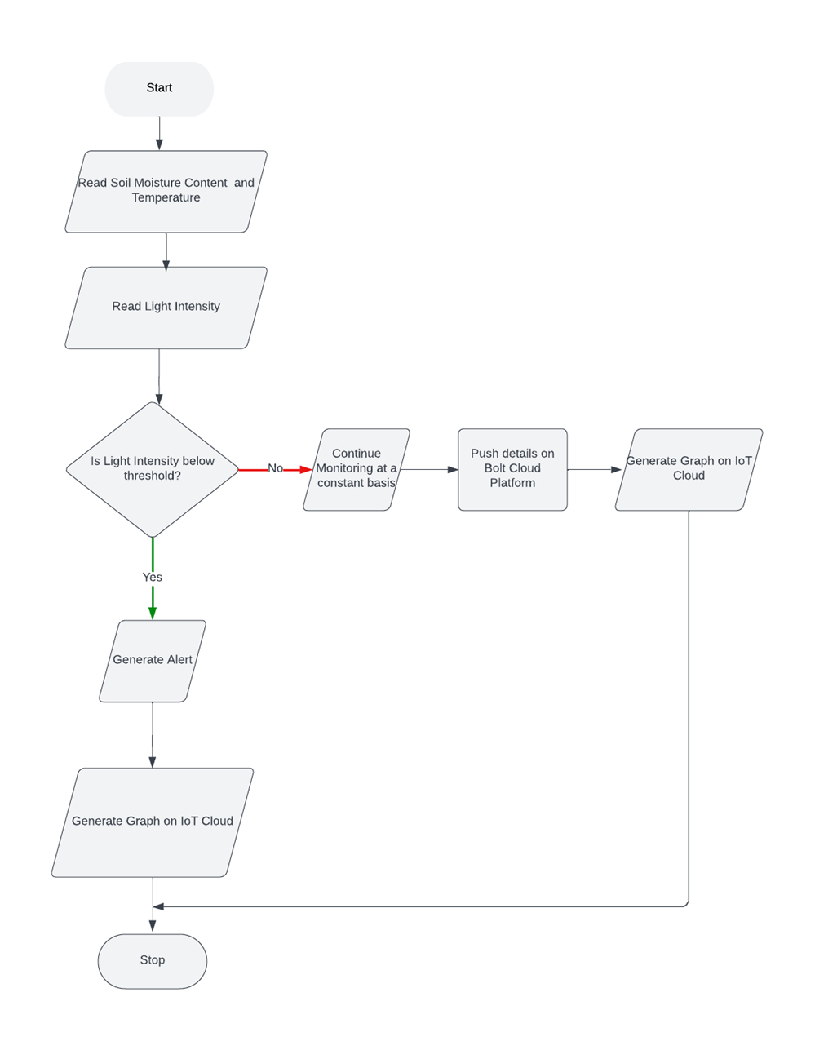



Sensor Data Acquisition: The system collects data from various sensors involving reading of Soil Moisture, Environment Temperature and Light Intensity.
Data Processing: This section depicts the processing of the sensor data including analyzing Soil Moisture and analyzing Light Intensity
Decision Points:
Is Watering Required?
Is increasing Light Intensity Required?
FLOWCHART

Slide 8
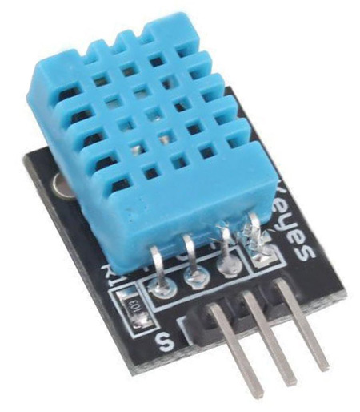
SENSOR DETAILS
Humidity measuring range: 20%~90%RH(0~50 degree (temperature compensation).
Temperature measuring range: 0~+50degree.
Humidity measurement accuracy: ±5.0%RH.
Temperature measurement accuracy: ±2.0degree.

Slide 9
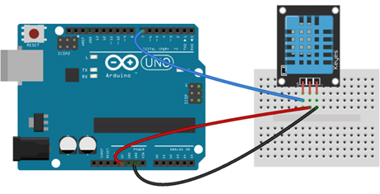
CONNECTIONS
01
02

Slide 10
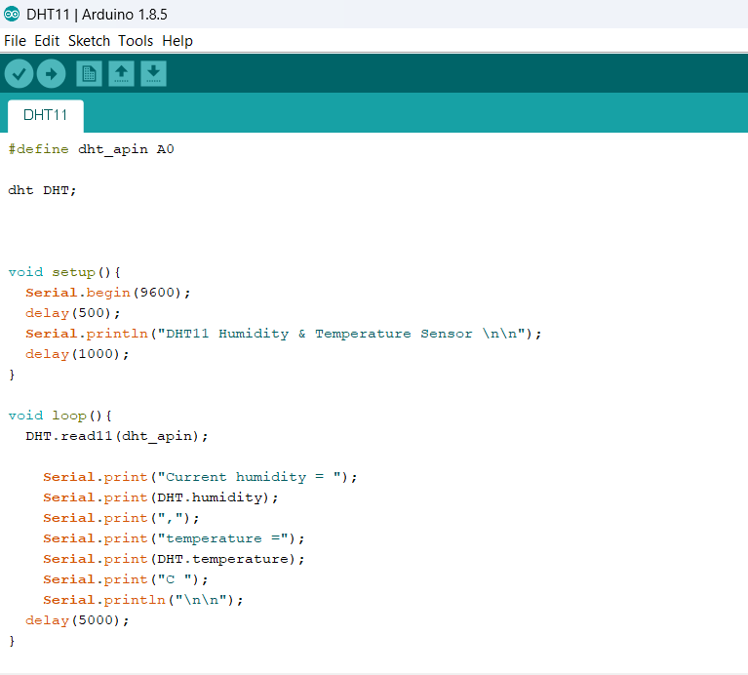
The code provides Arduino to read the Humidity and the Temperature from the DHT11 sensor and view it on the Arduino Serial Monitor.
ARDUINO CODE

Slide 11
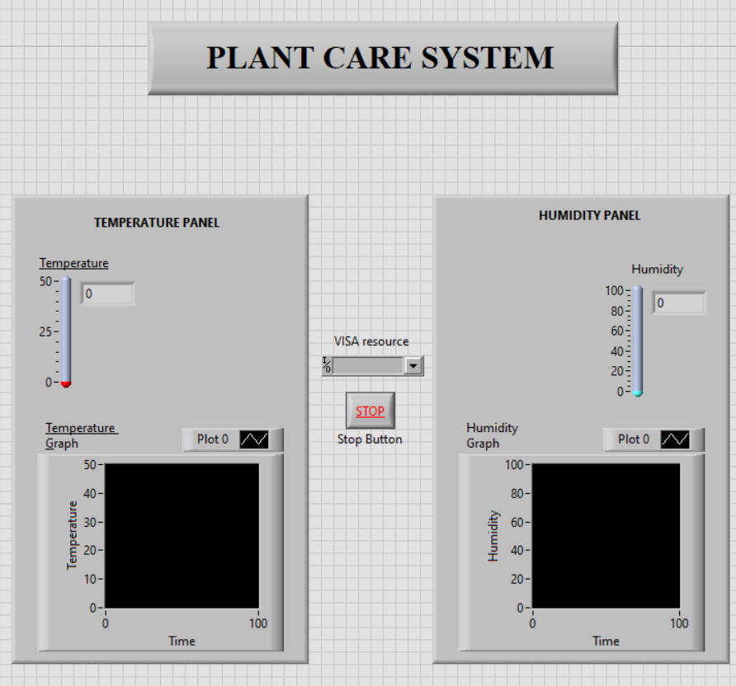
LAB-VIEW
FRONT PANEL
BLOCK DIAGRAM

Slide 12
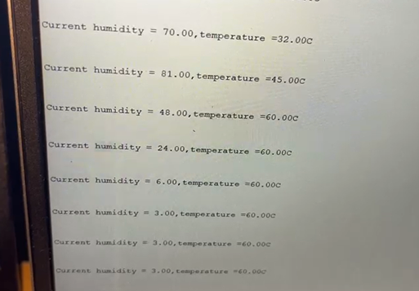
SIMULATIONS
TEMPERATURE AND HUMIDITY
LIGHT INTENSITY PLOT

Slide 13
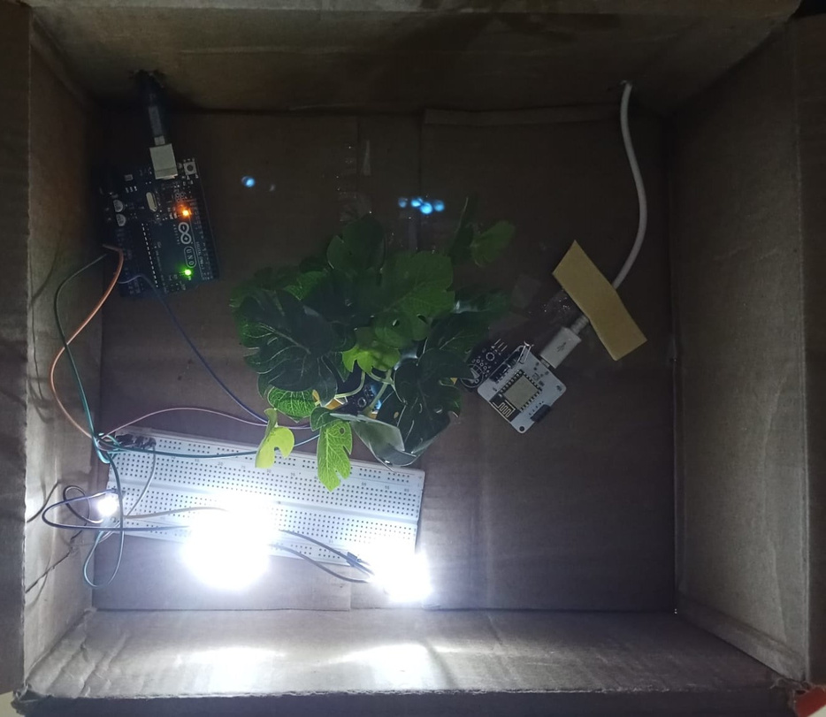
HARDWARE

Slide 14

CONCLUSIONS
The "Plant Care System – Soil Moisture and Light Intensity Level Detector" project represents a pioneering approach to addressing the growing need for efficient and sustainable plant care in various settings, including homes, gardens, agricultural fields, and urban environments.
This project aims to harness the power of modern technology to create a comprehensive and intelligent plant care solution that goes beyond traditional methods. By combining advanced sensors, Arduino, Wi-Fi Modules and user-friendly interfaces, this system endeavors to revolutionize how we nurture and sustain plant life.

